Slide 1

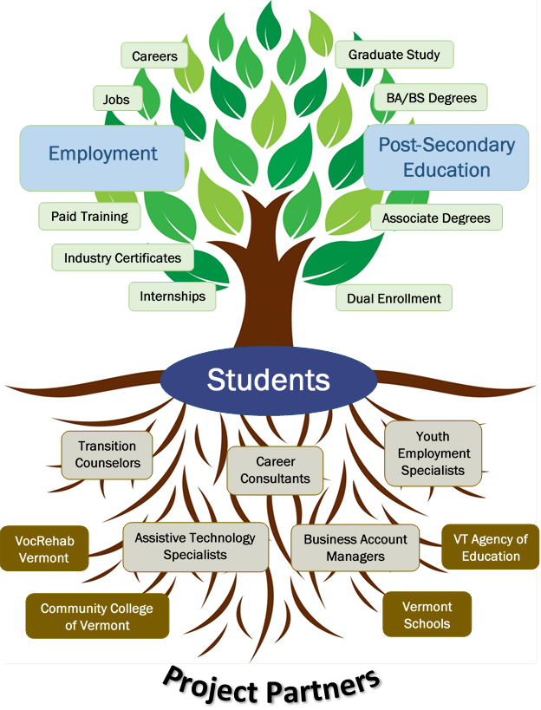
Student Outcomes
Eligibility and Enrollment:
High school sophomores & juniors on or eligible for an IEP or 504 Plan
Enrollment target: 800 students statewide over 2 years – 400 students each in the control & treatment groups
LLC is designed to achieve these student outcomes:
1. Being employed and succeeding in a paid, competitive job that is a stepping-stone to a career.
2. Being enrolled in & succeeding in a postsecondary program that will lead to a career.
3. Having confidence, on the part of the students & their families, that they will achieve their career goals.
To get there LLC will deliver:
1. Career development support via classroom, small group, & one-on-one services resulting in an individual LLC Plan
2. A variety of work-based learning experiences including:
a) at least one job shadow
b) at least one unpaid internship
c) at least one competitive, integrated, employer-paid job
3. Access to postsecondary education, including earning college credit while still in high school
4. Intensive, individualized Assistive Technology support
5. Transportation for WBL, employment & college activities

